Slide 1
Quantum Computing
Week 5

Slide 2

About Me
Shreya Patil
Data Scientist at Redapt
Masters in Data Science
Contact: spatil@redapt.com

Slide 3
Introduction
Quantum Computing (QC) is computing using quantum-mechanical phenomena, such as superposition and entanglement.
Physicist Richard Feynman has mentioned potential power of quantum computers in 1982.
Types of use cases are quantum simulation, quantum linear algebra for AI and machine learning, quantum optimization and search, and quantum factorization.
Use cases are largely experimental and hypothetical
Experts are still debating the most foundational topics for the field.
Possible commercial uses in pharmaceuticals, chemicals, automotive, and finance
Technology is rapidly advancing toward commercial viability.

Slide 4
Why QC ?

Slide 5
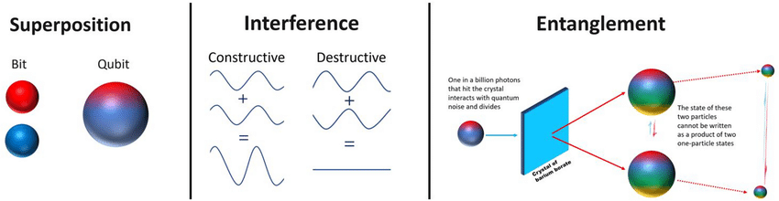
What is Quantum Computing ?
Quantum computing is a type of computation that harnesses the collective properties of quantum states, such as superposition, interference, and entanglement, to perform calculations.
Assume values that are a combination(superposition) of both 0 and 1.
Much faster than conventional computers.
Enables new computing algorithms.

Slide 6
Quantum Inspired Optimization
Quantum-Inspired Optimization algorithms have advantages of quantum computing on classical hardware, providing a speedup over traditional approaches.
A class of algorithms that are applied to solve optimization problems on traditional hardware.
Adiabatic quantum algorithms are well suited to solving many optimization problems.
What is the adiabatic theorem?
First, prepare a system and initialize it to its lowest energy state.
Next, slowly transform that system into a more complex one that describes the problem you're trying to solve.
The adiabatic theorem states that, as long as this transformation happens slowly enough, the system has time to adapt and will stay in that lowest energy configuration. When you're done with your transformations, you've solved your problem

Slide 7
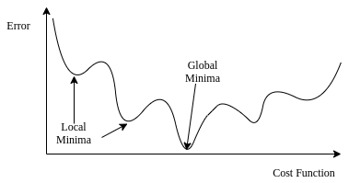
Optimization Basics
Cost Function
This is a mathematical function to be minimized. For the mineral transport, the cost function is the weight difference between the two space containers. In other scenarios, it might be length of travel or a monetary cost.
Search Space
This is the space that contains all the feasible solutions to the optimization problem. Each point in this search space is a valid solution to the problem, but it's not necessarily the lowest point, which corresponds to the lowest cost solution.
Together, the cost function and the search space are often referred to as an optimization landscape.

Slide 8
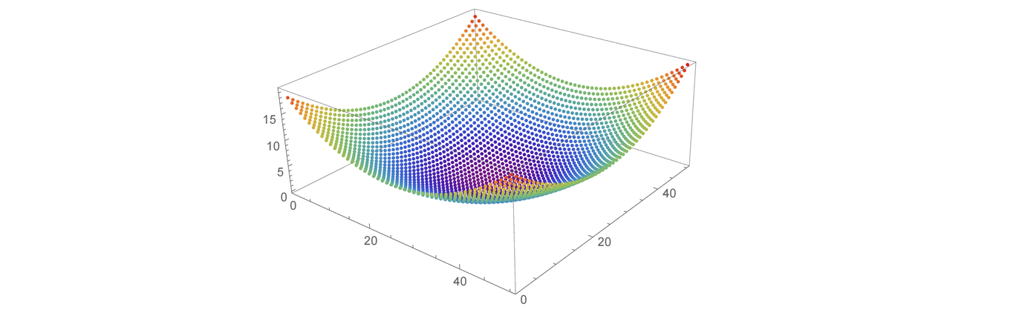
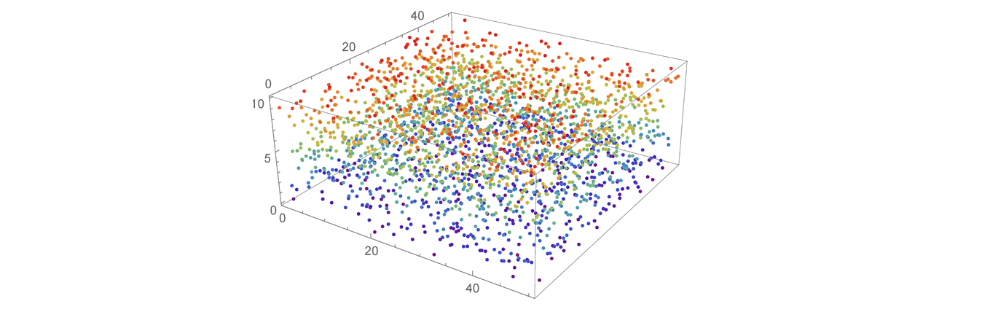
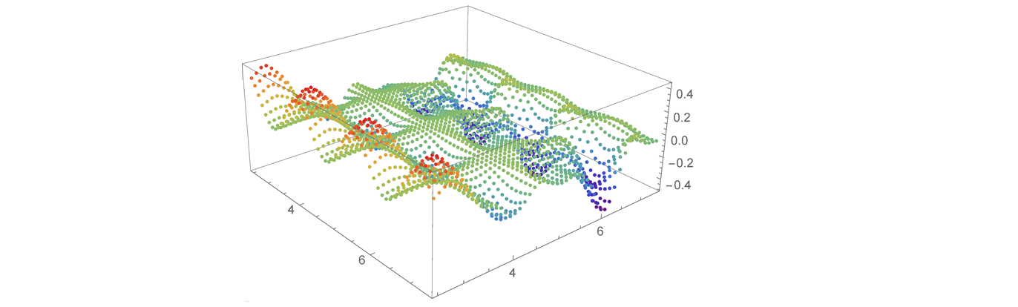
Optimization Landscape
Smooth Landscape
Scattered Landscape
Sweet spot for QIO
Structured Landscape

Slide 9
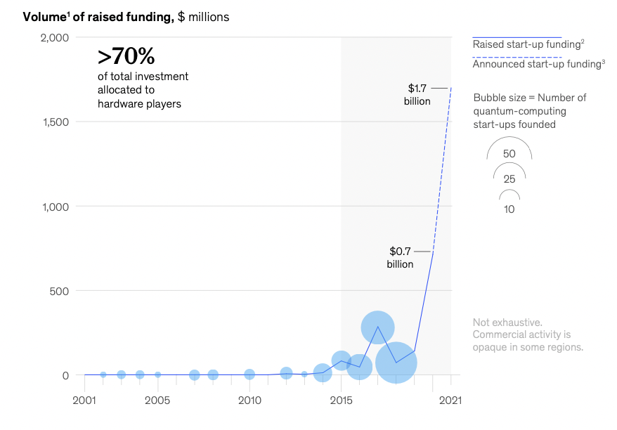
Fast developing ecosystem towards Quantum Computing
Funding
Private fundings are increasing.
In 2021 alone, quantum computing start-ups have surpassed $1.7 billion, more than double the amount raised in 2020.
Hardware
Hardware is a significant bottleneck in the ecosystem.
Technical issue of scaling the number of qubits in a quantum computer while achieving a sufficient level of qubit quality.
Structural issue of developing a fully error-corrected, fault-tolerant quantum computing hardware platforms.

Slide 10
Fast developing ecosystem towards Quantum Computing
Software
Software-focused startups is increasing faster in quantum-computing value chain.
Requires a new programming paradigm and software stack.
Cloud-based services.
Cloud may be the main way for early users to experience the technology until the larger ecosystem matures.
NASA, Google, IBM, CIA, etc. are working on quantum computers.

Slide 11
Industries for earliest use cases
Pharmaceuticals
Potential to revolutionize the research and development of molecular structures in the biopharmaceuticals industry.
Chemicals
Chemicals industry, which spends $800 billion on production every year, a realistic 5 to 10 percent efficiency gain would mean a gain of $20 billion to $40 billion in value.
Automotive
R&D, product design, supply-chain management, production, and mobility and traffic management.
Finance
Efficiently quantum-optimized loan portfolios and risk management.

Slide 12
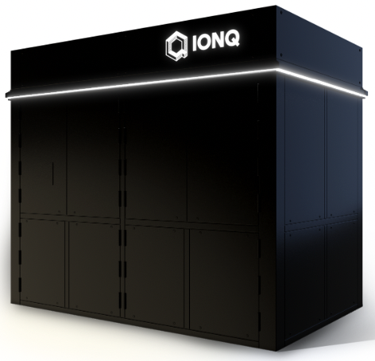
Quantum Computing Platforms
IonQ
IonQ is a quantum computing hardware and software company in Maryland, USA.
developing a general-purpose trapped ion quantum computer and software to generate, optimize, and execute quantum circuits.
IonQ is claimed to be "The world’s most powerful quantum computer”
IonQ can be accessed from all 3 major clouds.
approx 450 algorithmic qubits

Slide 13
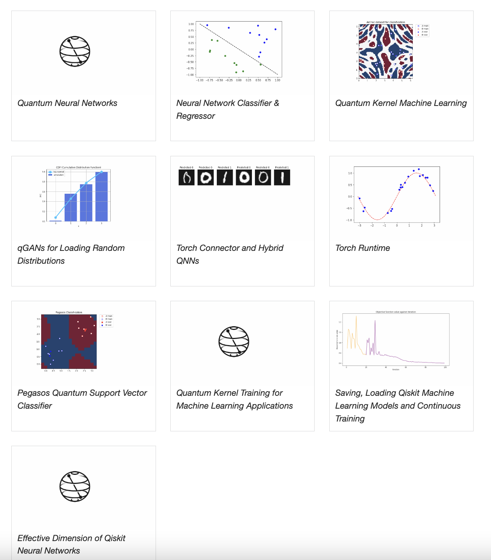
Qiskit
ML Tutorials
Qiskit is an open-source software development kit (SDK) for working with quantum computers at the level of circuits, pulses, and algorithms.
Qiskit a user workflow nominally consists of following four high-level steps
Build: Design a quantum circuit(s) that represents the problem you are considering.
Compile: Compile circuits for a specific quantum service, e.g., a quantum system or classical simulator.
Run: Run the compiled circuits on the specified quantum service(s). These services can be cloud-based or local.
Analyze: Compute summary statistics and visualize the results of the experiments.

Slide 14
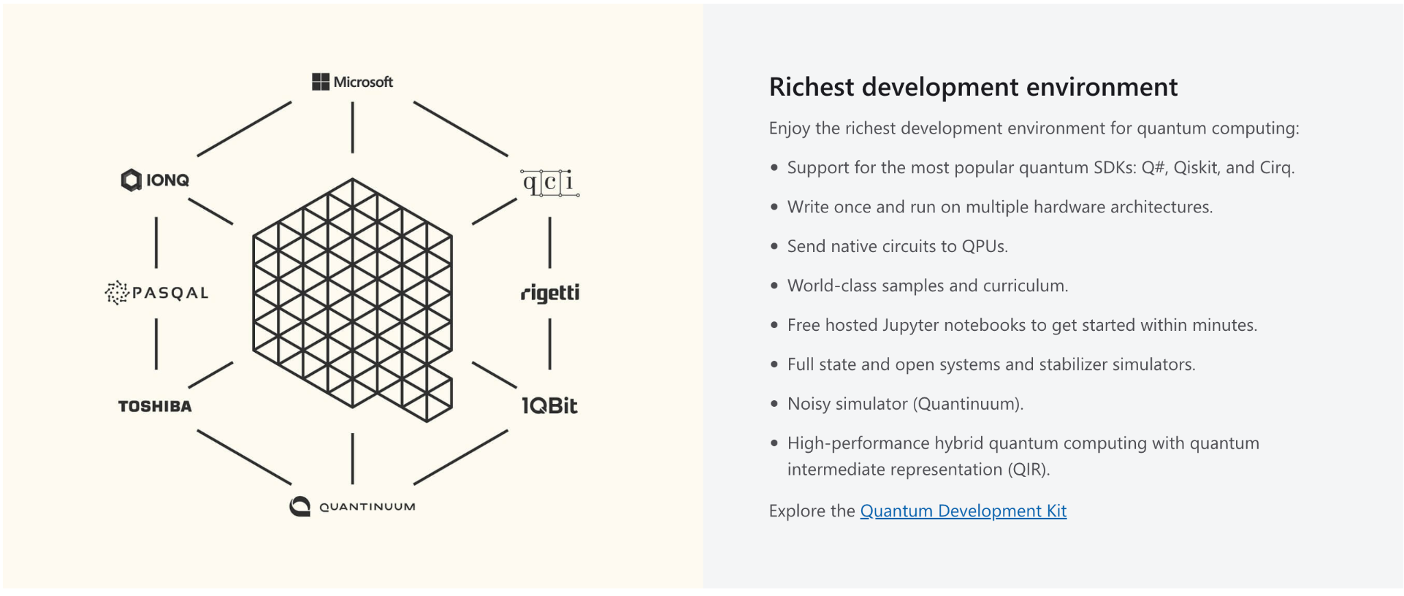
Microsoft Azure Quantum Computing
Richest development environment
Support for the most popular quantum SDKs: Q#, Qiskit, Cirq
Write once and run-on multiple hardware architectures
Send native circuits to QPUs.
Hosted Jupyter notebooks.
Full state and open system and stabilizer simulators
High performance hybrid quantum computing with quantum intermediate representation(QIR).

Slide 15
Six key factors affecting advances in quantum computing
Steady source of funding.
Democratized access to quantum hardware
Interfaces , programming languages and performance metrics standardization
Industry and academic consortia
Talent scarcity
Digital and analytical workflow for integration

Slide 16
Preparing for a quantum future
Collaborating with industry entities.
Facilitating access to knowledge and talent.
Identifying risks, disruptions and opportunities.
Recruiting quantum-computing talent.
Building digital infrastructure for operating demands.

Slide 17
Summary

Slide 18
Summary of the presentation Come to Redapt for your Quantum Computing needs :)

